Slide 1
Learning to Read Reading to Learn
Ormiston Cliff Park Primary Academy
September 2023

Slide 2
Why Early Reading Matters?
A critical communication tool
The rich language of books
Reading builds thinking skills
Reading unlocks creativity and develops children’s imagination
Reading helps to develop concentration
The “master skill” of school
Life chances
Good readers become good writers
Reading, alone and together, builds shared experiences, brings life-long joy and promotes well-being!

Slide 3
Where Does it all Begin?
Take a moment to read the following quote about reading:
“The more you read, the more things you will know. The more things that you learn, the more places you’ll go.” Dr Seuss
What skills and knowledge did you draw upon to be able to read and understand
it?

Slide 4
Without even thinking about it, you are likely to have:
Fixed your eyes on each word and swept your eyes automatically from left to right – instantly processing the inky marks on the screen into sounds
Transforming these sounds into words which have meaning, using your vast, existing knowledge of language and the wider world.
In order to do that, you need to have acquired a number of key skills….

Slide 5
Reading is a multi-skilled process

Slide 6
The Building Blocks for Reading - Semantics
Semantics is the science of words!
When we come across an unfamiliar word, we use clues- the rest of the sentence, the pictures or diagrams, words that resemble the unfamiliar one- to help us understand the meaning.
English has lots of words that can mean different things in different contexts!

Slide 7
Syntax
As well as the science of words, children need the science of sentences- syntax!
Our familiarity with the way words are arranged also helps us find the meaning of unfamiliar words.
Early readers gain the skills and knowledge of syntax to become early writers.

Slide 8
The Importance of Talk
To make sense of the world and develop their knowledge and creativity, children need to TALK!
Developing understanding of semantics and vocabulary comes from sharing words through talk.
READING FOLLOWS TALKING!
Talking partners at school.

Slide 9
Don’t underestimate the Power of the Picture Book to develop language and vocabulary! “Never step on a snail….” (From Shaun Tann’s ‘Rules of Summer’

Slide 10
What might the characters be saying/thinking/doing….? What if it wasn’t a Bear Hunt after all?

Slide 11
How would we use our knowledge of semantics and syntax to work out what the word ‘rabbit’ said?
The rabbit slept soundly in its cosy underground burrow.

Slide 12
Grapho-phonemic Cues
Our understanding of semantics and syntax will get us so far and plays a significant role in helping us to understand what we are reading but, to become an automatic and skillful reader, we also need to develop our grapho-phonemic awareness.
In other words, we need to be able to correlate written letters with the sounds that they make, in order to ‘hear’ the word on the page.

Slide 13
Phonics at Ormiston Cliff Park Primary Academy

Slide 14
Daily Phonics lesson
Phase 1 – two weeks of playing games which develop listening skills. We work on sound discrimination, alliteration, vocal sounds, rhythm and rhyme and begin some segmenting.
Phase 2 will start on 2nd Oct
We teach sounds every week – between 2 – 4 sounds each week
Each lesson children will practise letter-sound correspondence, segmenting and blending words, recognising common exception words on sight and applying their knowledge by reading or writing sentences
First sounds are S A T P I N
We use the correct terminology with the children, e.g. grapheme and phoneme, segment and blend
We use actions when segmenting and blending – robot arms + clap
Correct pronunciation is vital – you can watch ‘Jolly Phonics’ videos, use the sound mats we will provide in the homework books.

Slide 15
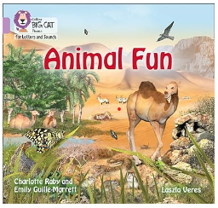
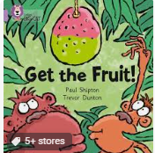
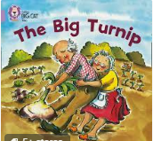
Home School books Picture books
Hold the book correctly, turn the pages
Develop talk
Build up vocabulary
Story structure
Start making predictions
Recall the content of book

Slide 16
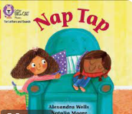
Decodable texts -matched to phonic knowledge -practice segmenting and blending - lots of word repetition

Slide 17
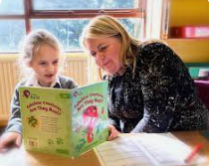
During the week, your child will share their book once with their teacher and once with the class teaching assistant
You can support your child’s reading development by sharing the book at home.
Please write in the reading diary – date and a short comment
Please bring the folder to school every day.
After three reads we can change the book.
Place the reading folder into the box outside the classroom when the book needs changing.

Slide 18
Literacy lessons support reading
Share a high quality text (linked to half term topic)
We spend time on new vocabulary
We model reading
Get to know the text well
Key words from the text will be displayed around the room
RAINBOW WORDS – introduced in Spring term
HOMEWORK – will include some phonics

Slide 19
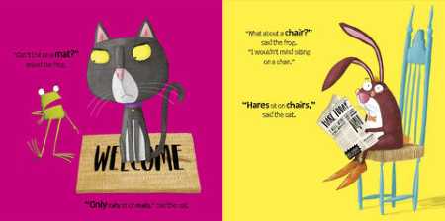
Phonics through Picture Books ‘Oi Frog!’ by Wes Gray & Jim Field

Slide 20
How do we support your child’s reading?
Your child’s reading book
Reading to an adult
Three reads approach– decode, fluency and comprehension
Picture books to share

Slide 21
Supporting Reading at Home
Little and often is best! Every time you read with your child you are modelling the process
Find a book which sparks their imagination
Encourage your child to hold the book and turn the pages
Talk about the book
Make it fun
Seek out new or interesting words

Slide 22
Share opinions and ask questions
Go ‘word spotting’
Word attack!
Use clues
Take turns

Slide 23
OCPPA Reading Champions Could You Help Us?

