Slide 1
Ormiston
Cliff Park Primary Academy
Parent workshop
Notes:
General Guidance about parent workshops
This workshop (if delivering in full) is designed to be completed in 50 minutes – 1 hour.
This workshop can be adapted and shortened to suit the priorities of your school. Select the parts that are purposeful for you.
See our parent workshop guidance for an overview of the structure to support you in adapting.
Additionally you may wish to add in information specific to your school e.g. photos, videos, calculation policy.
Have on the tables the termly parent packs - these are to be taken home after the workshop and contain the Big Picture, vocabulary, key representations and games discussed in the workshop. This can also be sent out to parents who were not able to attend the workshop.

Slide 2
What is Mathematics Mastery?
Success for all pupils
Based on research and evidence
Problem solving is at the heart
Focus is on depth, not acceleration
Aligned to National Curriculum
Focus on talk and reasoning about mathematics
Notes:
Purpose: To give an overview of Mathematics Mastery.
Facilitation: Explain that the school follows a mastery curriculum. Mastery reflects the needs of the 2014 curriculum (click) with a greater focus on talk and reasoning (click) with problem solving at its heart. (click) The programme is based on research and evidence from across the world (click) and the curriculum is designed so that all pupils can succeed (click) regardless of background and ability, with greater focus on exploring a problem in depth rather than moving onto something new, for example pupils will fully explore numbers within 20 before moving onto larger numbers.

Slide 3
Depth not acceleration
What do we mean by depth?
How do we deepen understanding?
Notes:
Purpose: To explain what we mean by depth.
Facilitation: Link to the previous slide, where it was noted that mastery is about having a deep understanding rather than moving on to something new, for example in year 1 the children will fully understanding numbers 1 – 20 before moving on to larger numbers. But what do we mean by depth? (click)
Explain that the Mathematics Mastery programme is based on three key principles (the dimensions of depth): conceptual understanding, language and communication and mathematical thinking.

Slide 4
Conceptual understanding
Representing a concept in different ways
Making connections between each way to deepen their understanding.
32
Notes:
Purpose: To explain how to develop conceptual understanding.
Facilitation: Have manipulatives out to show concrete examples of the number 32.
Explain in the following way: When a child first hears or see the number 32, they have little understanding of what it means: it’s only by seeing other representations that they build connections and develop understanding. (Animate slide)
Each representation build pupils' understanding of a different aspect of that number. For example: some of these representations place emphasis on place value (point out base ten/Dienes). Some of these help pupils to understand the order of numbers (number line). Some of these help pupils to see combinations to make 32 (part whole).
It’s important pupils see maths in different ways, make connections between these ways and deepen their understanding. Remember, just because a child knows how to say and count to 32 doesn’t mean that they know where it might lie on a number line, how far away it is from 40 or how to separate it into three tens and two ones etc.
Explain that at home parents can use everyday items such as buttons, coins, money. For place value, straws bundled into tens with an elastic band make a good representation.

Slide 5
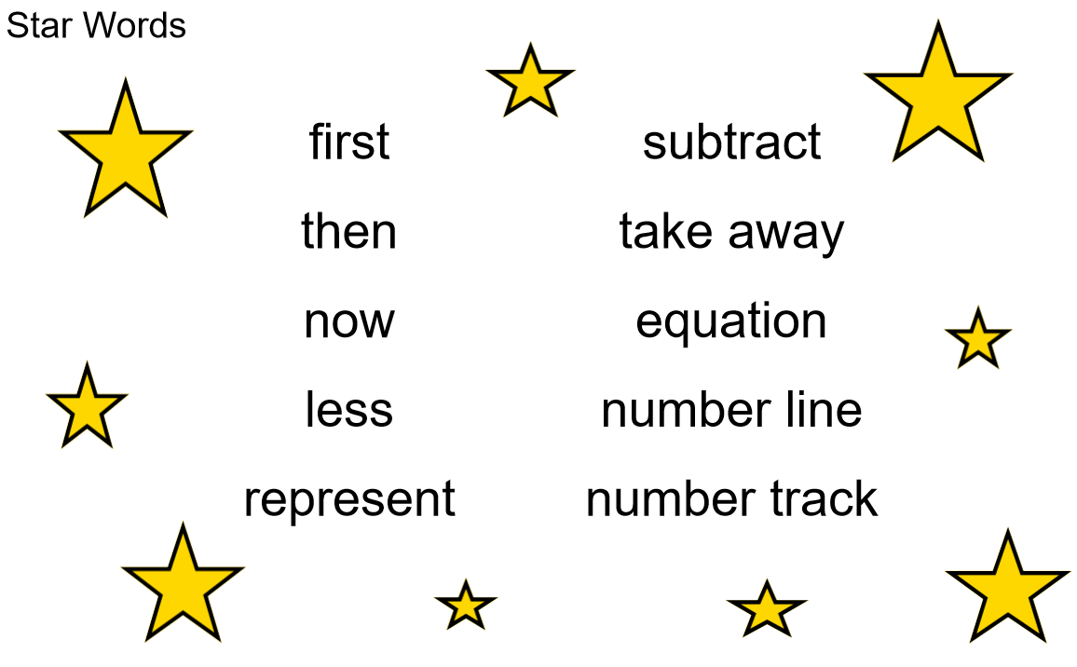
Language and communication
Can you say that in a full sentence, please?
Notes:
Purpose: To explain how to develop language and communication in maths.
Facilitation: We place an emphasis on pupils using precise mathematical vocabulary. Each lesson has key words, called star words.
Share that we encourage pupils to speak in full sentences. This supports them in applying that vocabulary and with more practise builds their ability to have a mathematical discussion and reason about the maths. Mathematical talk is central to all maths lessons and happens throughout the lesson. It helps to build pupils’ understanding and gives them opportunity to work together and share strategies.
Explain that when working with children at home parents should aim to talk about maths rather than give them a sheet of maths to do alone. They could try asking your child about this week’s star words, “What new maths words did you use today? How do you use them in a sentence?”. Emphasise that the more they discuss maths with their child the more they will get an idea of their understanding.

Slide 6
Mathematical thinking
Do you think … would always happen?
What’s the same? What’s different?
What do you think would happen if…?
How do you know that?
What else could go in this set? What couldn’t?
Can you see a pattern? What would come next?
Notes:
Purpose: To explain how to develop mathematical thinking.
Facilitation: Share in the following way: Pupils are encouraged to think mathematically which includes imagining, sorting and comparing, making connections to things that you already know, spotting patterns and drawing conclusions.
These are things children do without being taught and you may have noticed your child doing them in their play, e.g. pointing out patterns, or sorting their toys into groups according to certain properties.
The slide shows some question prompts to support your child with mathematical thinking.

Slide 7
Creating a positive attitude to maths
Talk to your children about everyday maths
Play maths games with them
Value mistakes as learning opportunities
Recognise that there is more than one way to work things out
Praise children for effort over outcome
Avoid saying things like “I’m useless at maths”
Notes:
Purpose: To give advice about opportunities to support with mathematics at home
Facilitation:
Share, making the following points:
Everyday Talk: try to talk about maths when doing activities like shopping, cooking, time etc. 5 minutes a day can make a big difference!
Play with your child: puzzles, board games, verbal games help them to apply vocabulary, problem solve and reason. Interaction and dialogue that you cannot get from playing on a computer or iPad!
Mistakes are opportunities for learning.
You may have learned one method at school but at school we actively encourage children to seek out multiple strategies and choose one that works for them and build connections between strategies.
Praise children for trying hard and overcoming challenges. If pupils are only praised for getting everything correct they may not try and challenge themselves as they may be afraid to get things wrong.
6) Try to avoid saying things like “I’m useless at maths”. You may remember maths as being hard, but if your child hears you saying that, or that it's not important to be good at maths, they will believe that too!

Slide 8
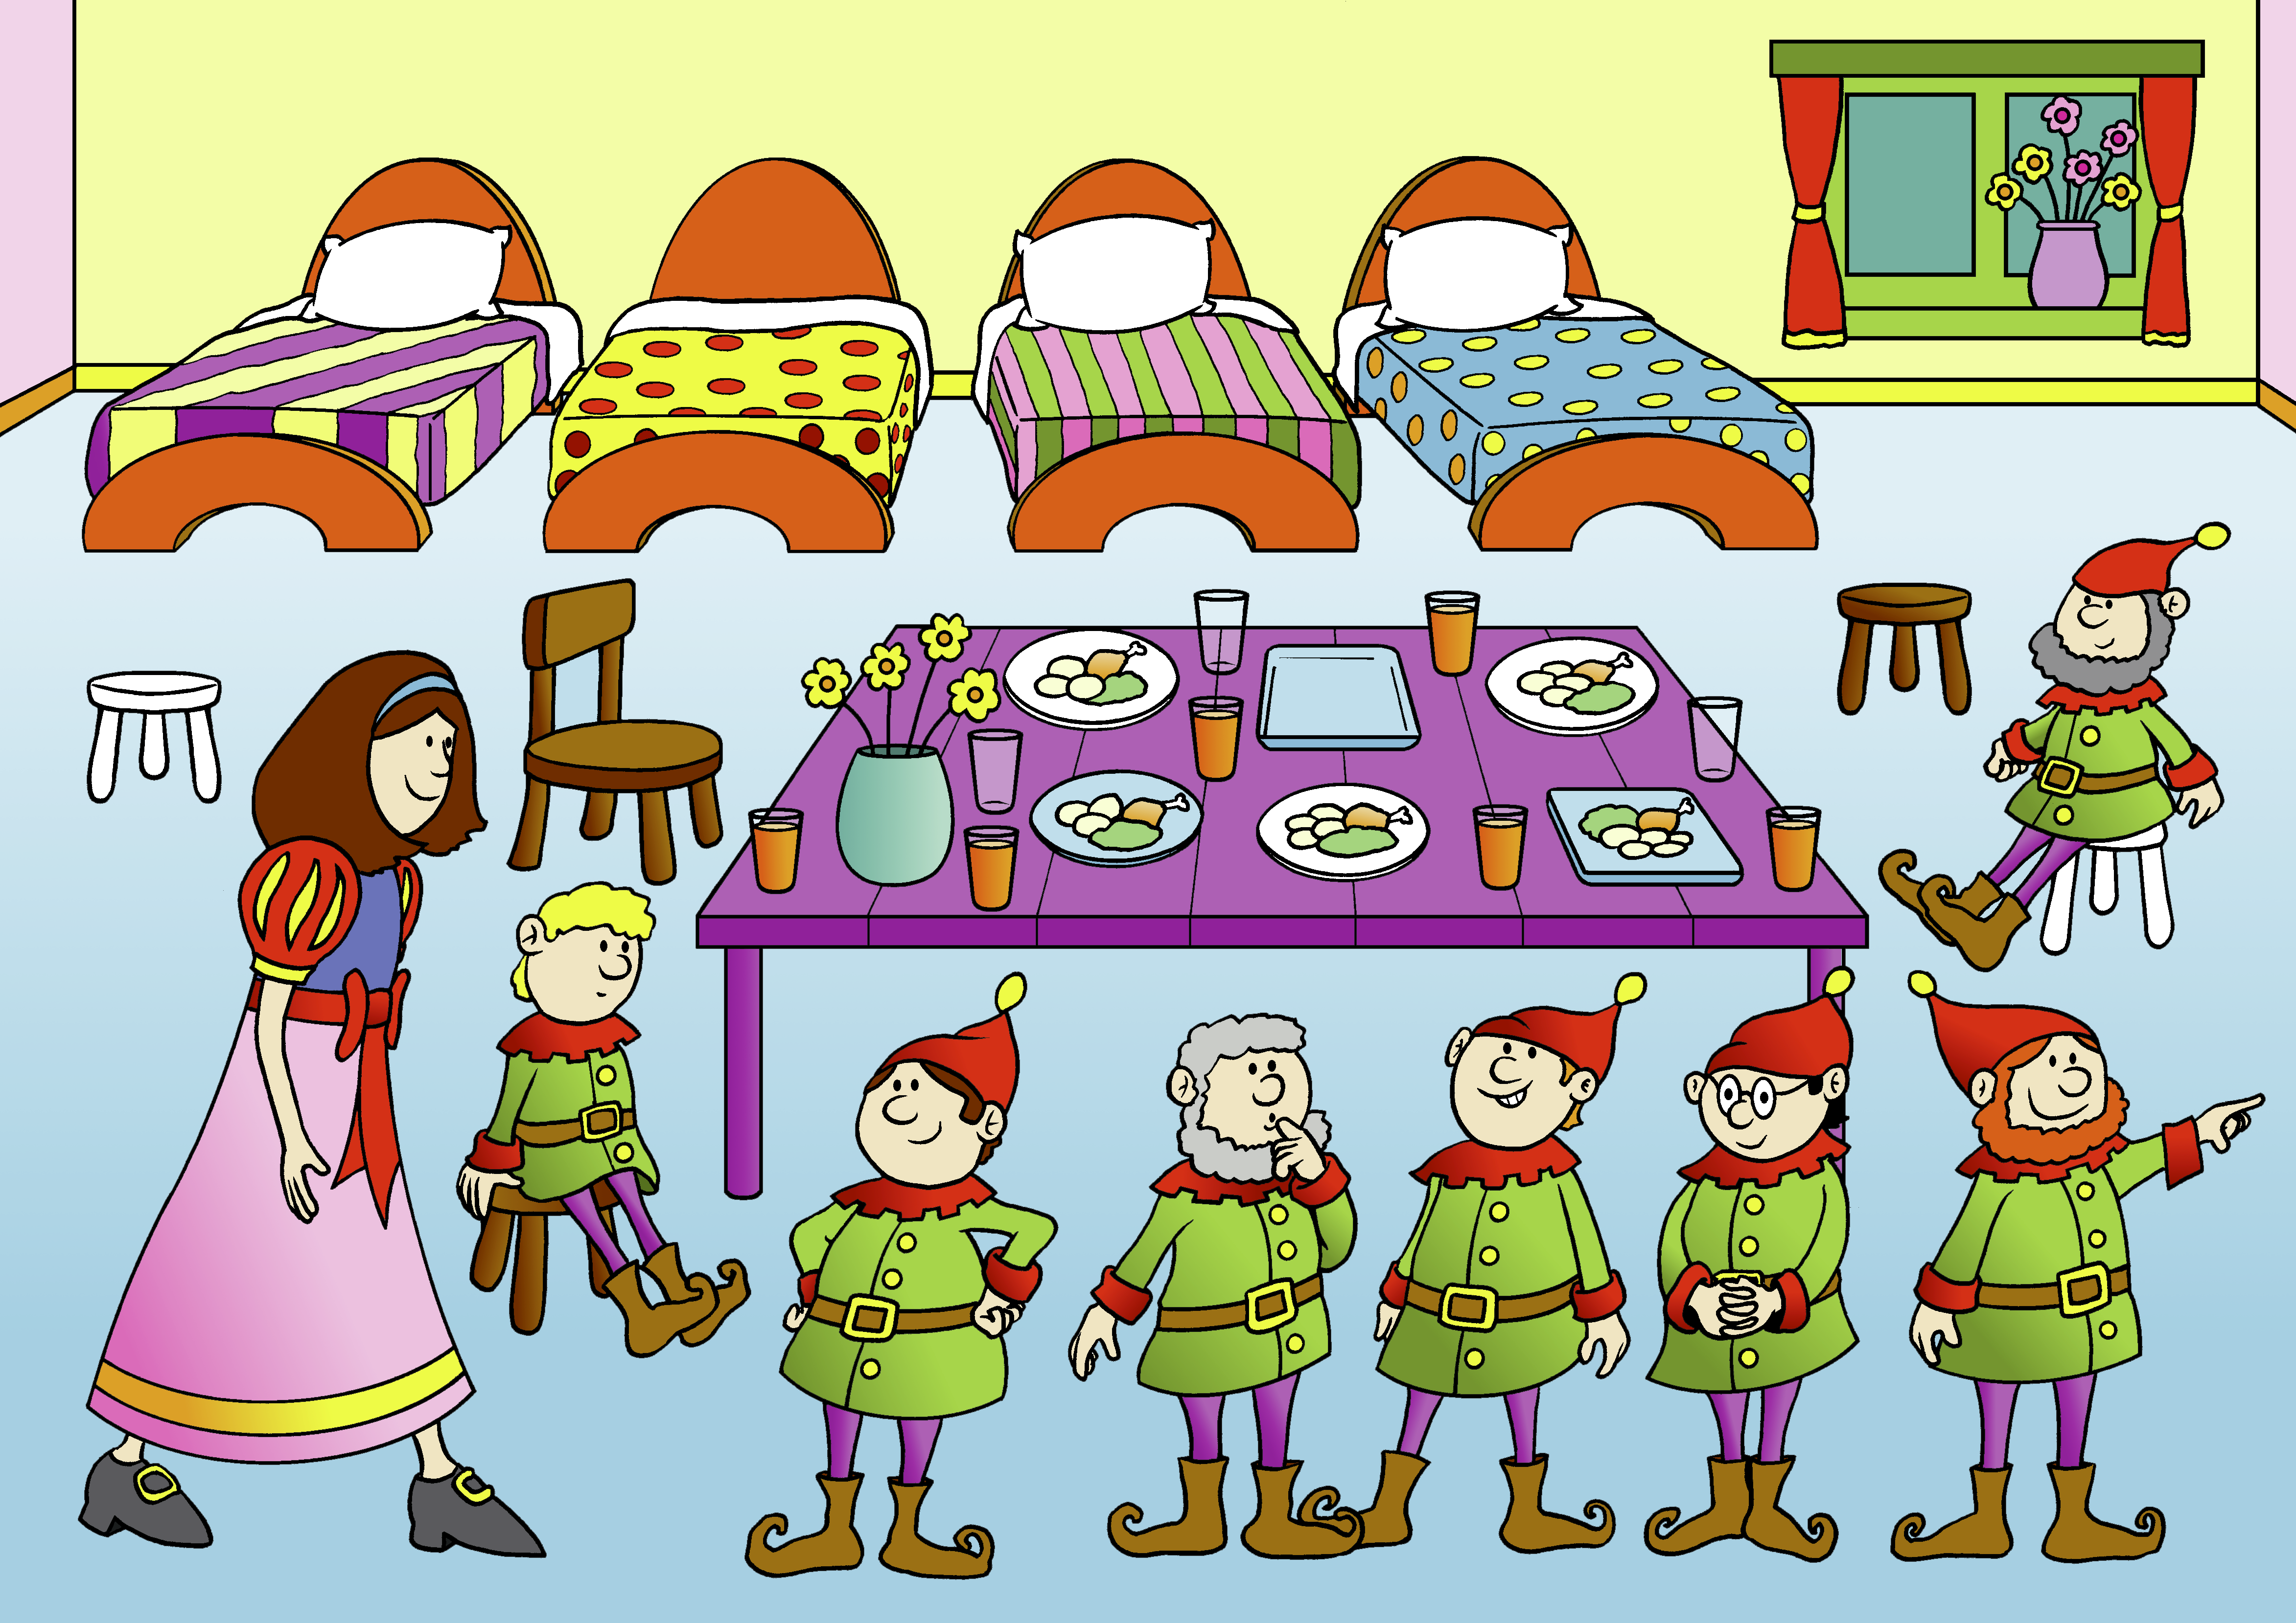
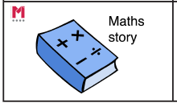
Big Pictures
Year 1
What maths can you see?
?
equation add addition plus is equal to part whole
Notes:
Time: 5 minutes
Purpose: To show parents how we use the big picture to connect maths to a context/the real world.
Facilitation: Explain that the big pictures are used to provide children with opportunities to connect maths with the real world, make connections and supports mathematical talk and reasoning. The Big Pictures in Year 1 relate to fairy tales and this is used in the addition and subtraction unit, which is our focus today.
Mathematics Mastery encourages pupils to make connections between the maths they are doing and real life contexts. Often pupils are asked to relate the maths they are doing to a real life problem which we call a “maths story”.

Slide 9
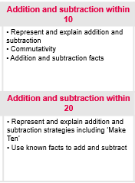
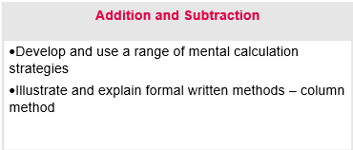
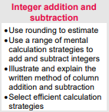
Addition and Subtraction Curriculum Map
Year 3
Year 1
UKS2

Slide 10
In focus: addition and subtraction
Year 1
Addition facts to 10 by combining amounts
Subtraction facts to 10 by partitioning
Explore related facts in addition and subtraction
Using number bonds to add within 20
Using the ‘make ten’ strategy to add within 20
Notes:
Purpose: To share the progressive learning steps pupils will follow for addition and subtraction.
Facilitation: In this workshop we have chosen to focus on addition and subtraction as this a big focus for us this term and learning from these units will be used and applied throughout the remainder of the year.
Explain that in Year 1, pupils are required to represent and use number bonds within 20. Mathematics Mastery is a cumulative curriculum meaning that learning is built over time, with new learning that makes connections to prior learning.
Pupils begin by using strategies to calculate number facts to ten. They use a combining strategy for an addition and a partitioning strategy for subtractions. Share that both of these will be explained in the workshop. Later in the term they use this learning to derive facts to 20.
By the end of the year pupils should be able to recall the number bonds to 10 but it is also important thy have a deep understanding of why those facts are correct and how they relate to the real world. This is why clear visual representations are used when we introduce the facts.

Slide 11
In focus: addition and subtraction
Year 2
Addition and subtraction of 2-digit numbers
Using number bonds in addition and subtraction
Adding and subtracting ones with a two-digit number
Adding and subtracting multiples of ten
Adding and subtracting tens with a two digit numbers
Adding and subtracting two 2-digit number
Adding three 1 digit numbers
Representing information in a bar model
Representing addition and subtraction word problems as a bar model
Notes:
Purpose: To share the progressive learning steps pupils will follow for addition and subtraction.
Facilitation: In this workshop we have chosen to focus on addition and subtraction as this a big focus for pupils this term and learning from these units will be used and applied throughout the remainder of the year.
Explain that in Year 2, pupils are required to use number bonds explored in Year 1 to calculate with numbers up to 100. Mathematics Mastery is a cumulative curriculum meaning that learning is built over time, with new learning that makes connections to prior learning. The slide shows each small progressive step in addition and subtraction this term.
Pupils begin by re-familiarising their number bonds and using these to make connections to other facts. They move on to calculating with two digit numbers using a range of strategies that link to facts they know. Pupils then look at addition and subtraction problems in context. Bar models are a pictorial representation used to show the mathematical structure of a problem and we will look at these later in the workshop.

Slide 12
In focus: place value
Year 3
Value of each digit in 3-digit numbers
Partition 3 digit numbers in different ways
Order and compare 3-digit numbers
Add and subtract 10 or 100
Round numbers to the nearest 10 or 100
Notes:
Purpose: To share the progressive learning steps pupils will follow for addition and subtraction.
Facilitation: In this workshop we have chosen to focus on place value as this is a big focus for us this term and learning from these units will be used and applied throughout the year.
In Year 3 pupils begin to explore numbers with up to three digits, they are expected to have a deep understanding of the value of each digit, for example in 258, they understand that the 2 is worth 200 and understand what 200 would look like in comparison to other numbers. They are expected to be able to split numbers into parts (partition) numbers in different ways then order and compare these numbers, find 10 less or more and finally round numbers to the nearest 10 and 100.
The learning in this unit aims to increase children’s number sense and will support pupils when they begin to do calculations later in the term and throughout the year. To fully understand the value of each digit in three digit numbers pupils use various resources and pictures to represent numbers.
Year 4, 5 and 6 is similar to year 3; however, the numbers get larger (up to 10 million including decimals)

Slide 13
Ten frame

Slide 14
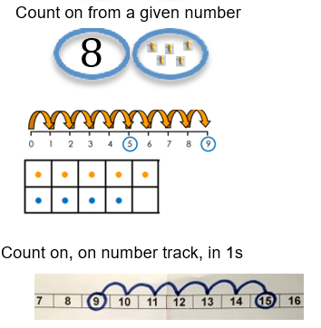
Counting on…

Slide 15
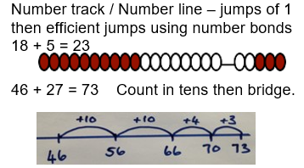
Counting on…

Slide 16
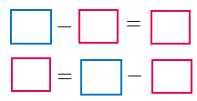
Part, part, whole model
10
19
9
$$+$$
$$=$$
$$=$$
$$+$$
equation add addition plus is equal to part whole
Notes:
Purpose: To introduce the part-whole model for addition
Facilitation: all pupils will be familiar with the part whole model shown and the language of parts and whole. (Indicate where the parts and whole are and point out the star words below). The part whole model supports pupils’ understanding of the structure of addition and subtraction. When we first begin using the part whole model we use concrete objects such as cubes to show pupils the process of addition and subtraction so that they can see how the amount changes. These concrete objects are used throughout the childrens development across our whole academy. This process is introduced in year 1, pupils will use these alongside equations and make connections between the two, understanding the position of the parts and whole.
Emphasise the importance of pupils using the language when calculating to support their understanding. Finally complete the equation, emphasising that it’s important that the is equal to sign is not always at the end of the equation.
This method will develop the security of number bonds, builds up the childrens fluency and shows a key link between addition and subtraction.

Slide 17
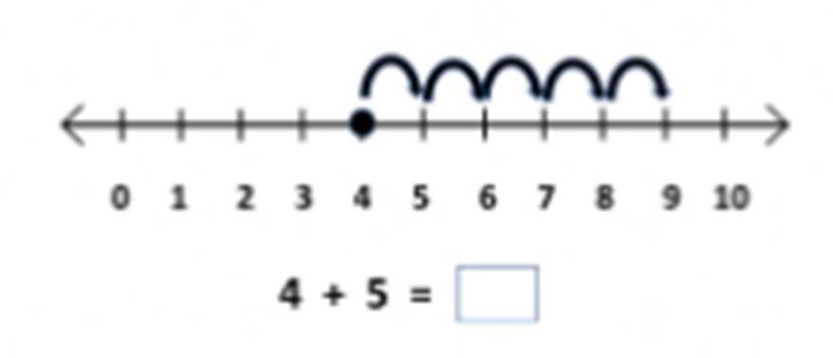
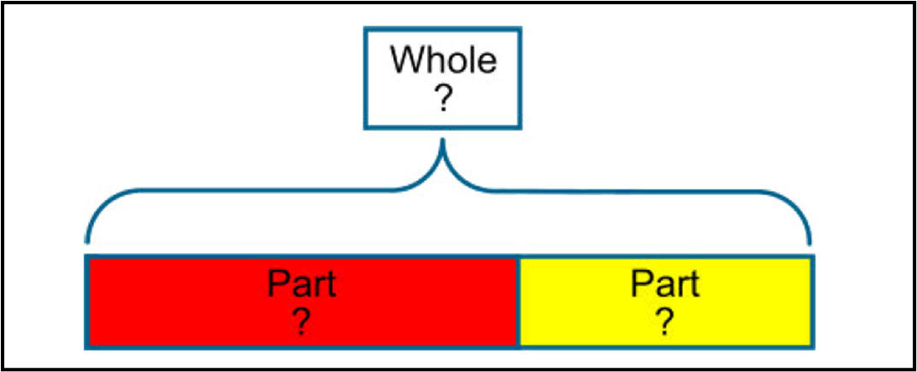
Part, part, whole model
10
19
9
Notes:
Purpose: To introduce the part-whole model for addition
Facilitation: all pupils will be familiar with the part whole model shown and the language of parts and whole. (Indicate where the parts and whole are and point out the star words below). The part whole model supports pupils’ understanding of the structure of addition and subtraction. When we first begin using the part whole model we use concrete objects such as cubes to show pupils the process of addition and subtraction so that they can see how the amount changes. These concrete objects are used throughout the childrens development across our whole academy. This process is introduced in year 1, pupils will use these alongside equations and make connections between the two, understanding the position of the parts and whole.
Emphasise the importance of pupils using the language when calculating to support their understanding. Finally complete the equation, emphasising that it’s important that the is equal to sign is not always at the end of the equation.
This method will develop the security of number bonds, builds up the childrens fluency and shows a key link between addition and subtraction.

Slide 18
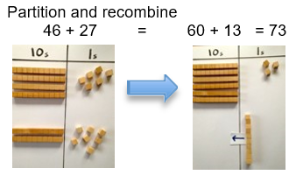
Part, part whole to help with addition

Slide 19
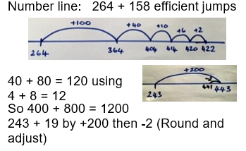
Using a number line

Slide 20
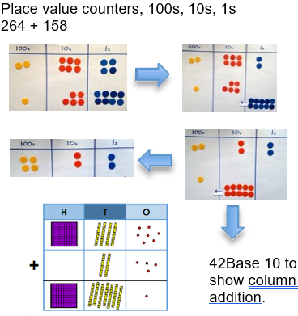
Concrete, pictorial and abstract

Slide 21
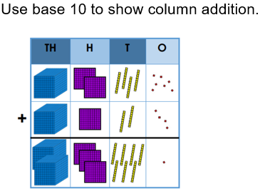
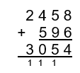
Concrete, pictorial and abstract

Slide 22
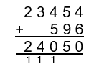
What do you notice?

Slide 23
Counting on…
Notes:
Which is why we teach addition and subtraction together.
You will notice lots of similarities between addition and subtraction.

Slide 24
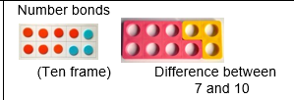
Subtraction

Slide 25
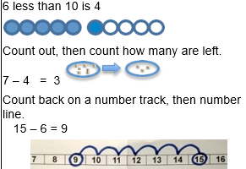
Introduction of number lines in Year 1

Slide 26
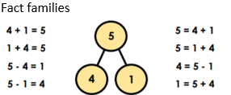
Part, part whole to develop fluency

Slide 27
Ensuring knowledge is developed

Slide 28
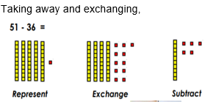
Concrete, pictorial and abstract

Slide 29
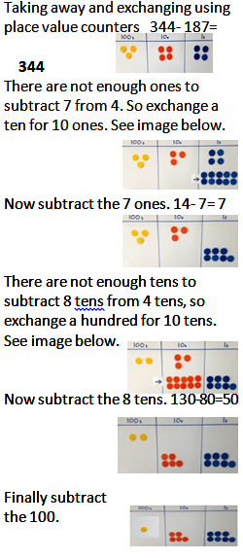
Place value to help understand formal method

Slide 30
The answer is only the beginning
The teacher presents a maths problem and then asks:
Describe the method/procedure you used
Why does the method work, what relationships are involved, what generalities or rules can we glean?
What is the answer?

Slide 31
How can you help?
Questioning
This can be done simply by asking children to explain how they worked out a calculation or solved a problem, and to compare different methods.
Fluency Drive
Support your child with their:
-Number bonds;
-Multiplication and division facts;
-Inverses.

Slide 32
Thank you
Notes:
Thank parents for attending the workshop and take any questions afterwards.

