Slide 1

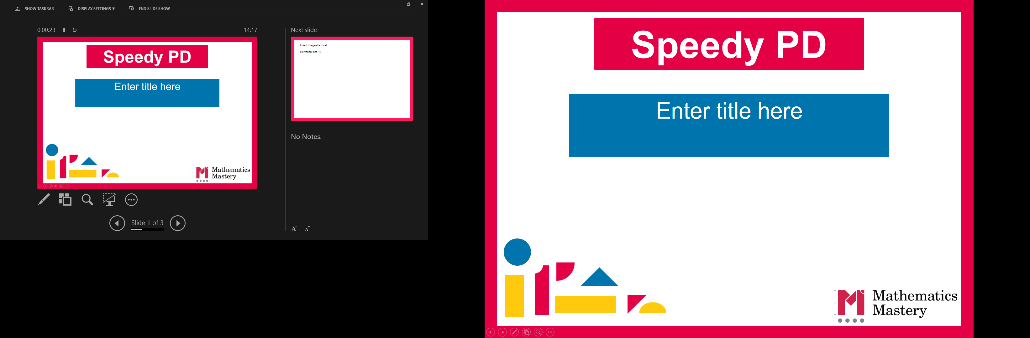

Reception
Parent workshop
Notes:
General Guidance about parent workshops
This workshop (if delivering in full) is designed to be completed in 50 minutes – 1 hour.
This workshop can be adapted and shortened to suit the priorities of your school, select the parts that are purposeful for you.
See our parent workshop guidance for an overview of the structure to support you in adapting.
Additionally you may wish to add in information specific to your school e.g. photos, videos, website links, calculation policy.
Have the termly parent packs already on the tables - these are to be taken home after the workshop and contain the big picture, vocabulary, key representations and games discussed in the workshop. This can also be sent out to parents who were not able to attend the workshop.
Resources
Counters
Countable objects e.g. small play, everyday items
Bead strings
Ten frames
Five frames
Dot cards (see folder)

Slide 2
What is Mathematics Mastery?
Reception
Success for all pupils
Based on research and evidence
Problem solving is at the heart
Focus is on depth, not acceleration
Reflects the 2014 National curriculum
Focus on talk and reasoning about mathematics
Notes:
Time: 10 – 15 minutes for introduction slides 1 – 6.
Purpose: To give an overview of Mathematics Mastery.
Facilitation: Explain that the school follows a mastery curriculum. Mastery reflects the needs of the 2014 curriculum (click) with a greater focus on talk and reasoning (click) with problem solving at its heart. (click) The programme is based on research and evidence from across the world (click) and the curriculum is designed so that all pupils can succeed (click) regardless of background and ability, with greater focus on exploring a problem in depth rather than moving onto something new, for example pupils will fully explore numbers within 20 before moving onto larger numbers.

Slide 3
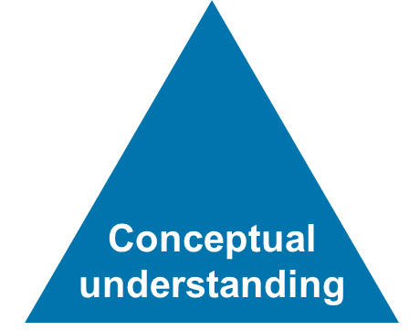
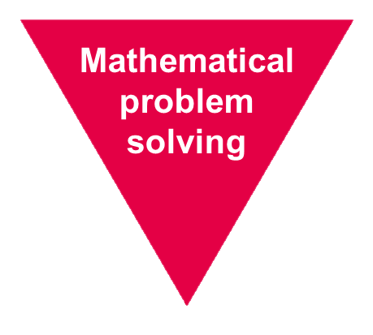
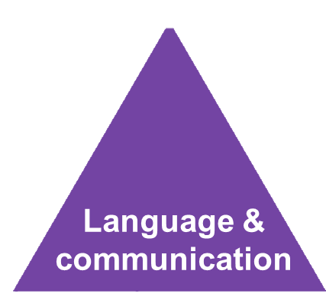
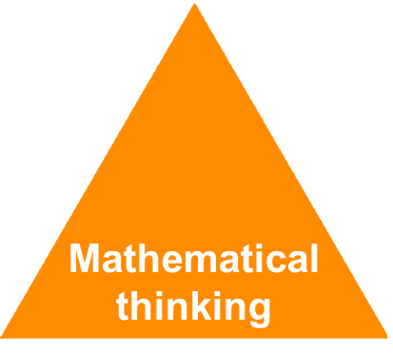
Depth not acceleration
Reception
What do we mean by depth?
How do we deepen understanding?
Notes:
Time: 10 – 15 minutes for introduction slides 1 – 6.
Purpose: To explain what we mean by depth.
Facilitation: Link to previous slide that mastery is about having a deeper understanding of a concept rather than moving on to something new, for example fully understanding numbers 1 – 5 before moving on to numbers 1-10. But what do we mean by depth? (click)
Mathematics Mastery is based on three key principles (the dimensions of depth): Language and communication (click) mathematical thinking (click) and conceptual understanding (click). Research shows that these three aspects lead to a depth of understanding and ultimately success in mathematics, allowing children to become better mathematicians and thus better problem solvers. (click)

Slide 4
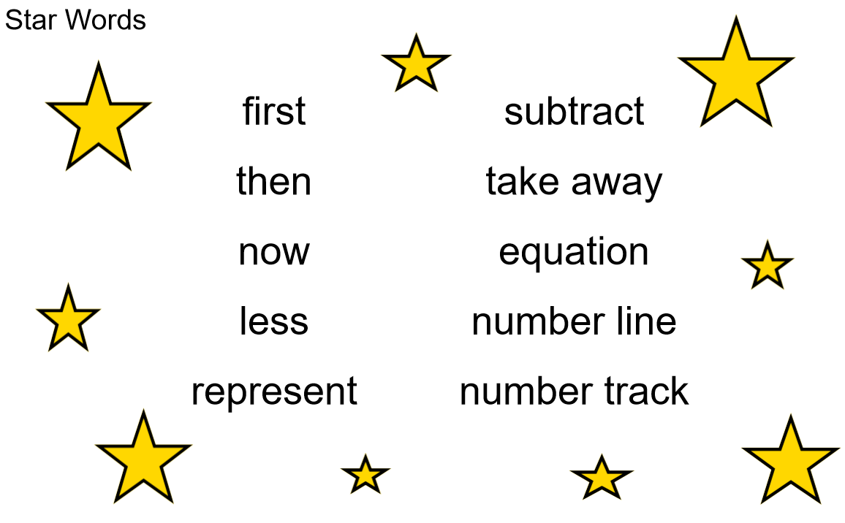

Language and communication
Reception
Can you say that in a full sentence, please?
Notes:
Time: 10 – 15 minutes for introduction slides 1 – 6.
Purpose: To explain how to develop Language and Communication in maths.
Facilitation: Emphasise that the programme and your school place an emphasis on pupils using precise mathematical vocabulary. Each lesson has key words, called star words, and there will be some of this term’s star words included in the parent pack to take home.
Share that we encourage pupils to speak in full sentences. This supports them in applying that vocabulary and with more practise builds their ability to have a mathematical discussion and reason about the maths. Mathematical talk is central to all maths lessons and happens throughout the lesson. It helps to build pupils’ understanding and gives them opportunity to work together and share strategies.
Explain that when working with children at home parents should aim to talk about maths rather than give them a sheet of maths to do alone. They could try asking your child about this week’s star words, “What new maths words did you use today? How do you use them in a sentence?”. Emphasise that the more they discuss maths with their child the more they will get an idea of their understanding.

Slide 5
Mathematical thinking
Reception
Do you think … would always happen?
What’s the same? What’s different?
What do you think would happen if…?
How do you know?
What else could go in this set? What couldn’t?
What pattern can you see? How would it continue?
Notes:
Time: 10 – 15 minutes for introduction slides 1 – 6
Purpose: To explain how to develop Mathematical Thinking.
FacilitationShare in the following way: Pupils are encouraged to think mathematically which includes imagining, sorting and comparing, making connections to things that you already know, spotting patterns and drawing conclusions.
These are things children do without being taught and you may have noticed your child doing them in their play, e.g. pointing out patterns, or sorting their toys into groups according to certain properties.
The slide shows some question prompts to support your child with mathematical thinking.

Slide 6

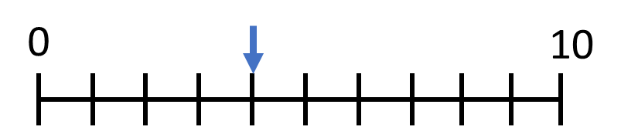
Conceptual understanding
Reception
Representing a concept in different ways
Making connections between each way to deepen their understanding.
four
4
Notes:
Time: 10 – 15 minutes for introduction slides 1 – 6.
Purpose: To explain how to develop Conceptual Understanding.
Facilitation: Have manipulatives out to show concrete examples of the number 4.
When a child first hears or see the number 32, they have little understanding of what it means, it is just an abstract symbol Children need to see it represented in lots of different ways and make connections - understand that they all represent the same thing. (Animate slide) Representations can be concrete e.g. anything that your child can move around, pictorial – anything your child can draw or abstract which holds no meaning by itself such as the spoken word, numerals or word.
Each representation helps your children understand a different aspect of that number.
For example: some of these representations place emphasis on the value of the number (five frame model). Some of these help pupils to understand the order of numbers (number line). It’s important pupils see maths in different ways, make connections between these ways and deepen their understanding. Remember just because a child knows how to say and count to 4 doesn’t mean that they know where it might lie on a number line or how far away it is from 5 or 10 or how to separate it into three and one, to groups of two etc.

Slide 7

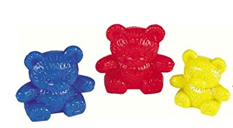
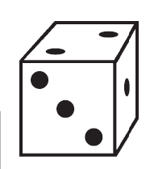
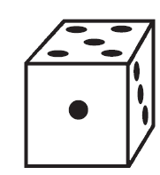
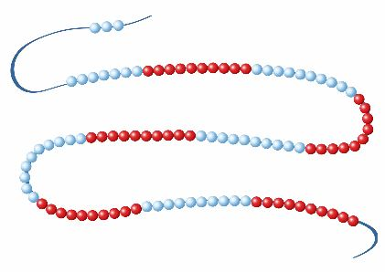

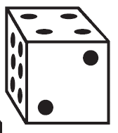

Representing numbers 1 – 6
Reception
Autumn Term
three
How many ways can you represent the number 3?
$$3$$
What does each representation tell us about the number three?
Notes:
Time: 6-7 minutes
Purpose: To allow parents to explore different ways of representing the same number.
Facilitation: Have a range manipulatives and pictorial representations out of the table: e.g. bead string, part-whole model, five frame, counters, cubes, small world items e.g. teddy bears as well as whiteboards and whiteboard pens.
Explain that in order to develop understanding, pupils need to make connections between different representations and they will have opportunities during the lessons to see each number to six in different ways to develop a deeper understanding. That is why pupils in this term solely focus on these numbers, we want them to have a secure understanding as it’s important for calculation skills later on in their schooling.
Invite parents to make the number three in various ways. Ask them what each representation might tell us about the number 3.
E.g. compliments to three, size of three, on to ne correspondence, conservation of number, cardinality etc.

Slide 8
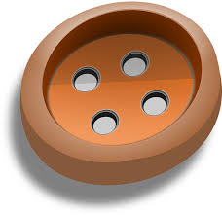
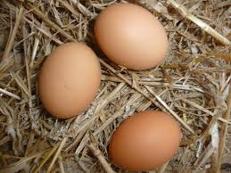

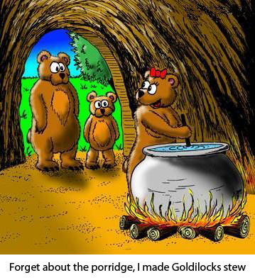



Using every day objects and the environment
Reception
Notes:
Time: 1 minute
Purpose: To share some ideas of ways to use concrete representations at home.
Facilitation: Explain that we don’t expect you to have the same resources we use at school - there plenty of every day items you can use. For example: buttons, coins, straws, dried pasta, tins, toys, teddy bears.
Also look out for numbers in the environment. Who can spot the number three on the walk to school? This can include the numeral as well as sets of three objects.

Slide 9
Creating a positive attitude to maths
Reception
Talk to your children about everyday maths
Play games with them
Value mistakes as learning opportunities
Recognise that there is more than one way to work things out.
Praise children for effort over outcome.
Avoid saying things like “I’m useless at maths”.
Notes:
Time: 2 minutes (possibly change wording, from dos and don’ts)
Purpose: To give advice about opportunities to support with mathematics at home
Facilitation: Share, making the following points:
Everyday Talk: try to talk about maths when doing activities like shopping, cooking, time etc. 5 minutes a day can make a big difference!
Play with your child: puzzles, board games, verbal games help them to apply vocabulary, problem solve and reason. Interaction and dialogue that you cannot get from playing on a computer or iPad!
Mistakes are opportunities for learning.
You may have learned one method at school but at school we actively encourage children to seek out multiple strategies and choose one that works for them and build connections between strategies.
Praise children for trying hard and overcoming challenges. If pupils are only praised for getting everything correct they may not try and challenge themselves as they may be afraid to get things wrong.
6) Try to avoid saying things like “I’m useless at maths”. You may remember maths as being hard, but if your child hears you saying that, or that it's not important to be good at maths, they will believe that too!

Slide 10

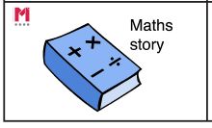
Big Pictures
Reception
What maths can you see?
?
number order greater less more fewer same equal before after between
Notes:
Time: 5 minutes
Purpose: To show parents how we use the big picture to connect maths to a context/the real world.
Facilitation: Explain that Big Pictures are used to provide children with opportunities to connect maths with the real world, make connections and support mathematical talk and reasoning. Give parents a copy of the Mother Hubbard Big Picture (in parent pack, or display on the board) and explain that the Big Pictures in Reception are all related to nursery rhymes that the pupils spend time singing along to. This one is used in the numbers to fifteen unit, which is our focus today. Allow them to discuss what maths they can see with their children and take some feedback.
Mathematics Mastery encourages pupils to make connections between the maths they are doing and real contexts. Often pupils are asked to relate the maths they are doing to a real life problem which we call a “maths story”.

Slide 11
Reception Spring Curriculum Map
Reception
Numbers within 10 | Addition and subtraction within 10 | Numbers within 15
Count up to ten objects Represent, order and explore numbers to ten One more or fewer, one greater or less | Explore addition as counting on and subtraction as taking away | Count up to 15 objects and recognise different representations Order and explore numbers to 15 One more or fewer
Grouping and sharing | Numbers within 20 | Doubling and Halving
Counting and sharing in equal groups Grouping into fives and tens Relationship between grouping and sharing | Count up to 10 objects Represent, order and explore numbers to 15 One more or fewer | Doubling and halving Relationship between
Notes:
Time: 3 minutes
Purpose: To share the Spring curriculum map with parents.
Facilitation: Allow parents to view the Reception curriculum map for Spring and briefly talk through the focus of each unit (no need to go through the individual objectives)
Explain that the Spring map is in the parent pack.
You may want to handout entire Reception curriculum map for parents to take home. Entire curriculum map:
http://toolkit.mathematicsmastery.org/download/5ce3b97817654

Slide 12
In focus: numbers to 20
Reception
Numbers within 15
Count up to 15 objects and recognise different representations Order and explore numbers to 15 One more or fewer
To be able to count up to 15 objects and place them in order
To know what is one more than a number within 15
To know what is one fewer than a number within 15
To apply knowledge of one more and one fewer
To use the 'guess and check' strategy for problem solving
To be able to order numbers within 15
To explore numbers within 15
Notes:
Time: 2 minutes
Purpose: To share the progressive learning steps for number.
Facilitation: Explain that each unit is broken down into small progressive steps. This term pupils will spend/have spent three weeks exploring numbers within ten, before moving on to numbers to fifteen in depth and finally numbers to 20. Pupils need to do more than just be able to count, they will need to be able to know what one greater or less than a given number is, be able to order numbers, problem solve and reason with numbers and are expected to show their answers in different representations and explain their thinking. This helps them to gain a greater understanding of the structure of numbers which will help them later when calculating. The slide shows how one of the mentioned units - ‘numbers to 15’ - is broken down into steps.

Slide 13
Key early number skills
Reception
Counting Principles
Associating one object with one number - One to one principle.
The order of number names remains consistent e.g. 1,2,3 not 2,3,1 -Stable order principle
The final word tells us the number of objects - Cardinal principle .
You can count any collection of things whether real, imaginary or sounds - Abstraction principle.
It doesn’t matter what order we count objects in - Order irrelevance principle
Notes:
Time: 6-7 minutes
Purpose: To share and explain key early number skills.
Facilitation: So what do we mean by fully understanding numbers? When counting, just knowing the number names isn’t the only thing your child needs to understand. Lets have a look at the principles of counting. (MMSL note: first identified by Gelman and Gallistel, 1978, but know integral to EY practice)
Have a range of everyday objects out to demonstrate each principle. If you are not confident in demonstrating a video has been included on slide 15, which you may prefer to show.
One to one correspondence – matching a number with an object.
Stable order – Numbers should be named in order, 1,2 3, some children may begin counting in order but may count another set of numbers in a different order, or miss numbers out e.g 1,2,4,5,3,
Cardinal principle - refers to the number of objects as a whole; developing an understanding of the ‘three-ness of three’ rather than a number in a sequence of numbers: 1, 2, 3. The final number in the count represents the cardinal value of the number.
Abstraction principle - counting objects that are not visible such as hand claps, dropping coins into a tin.
Order irrelevance - to understand that objects can be counted in any order. For example, counting does not have to take place from left to right – they can be counted in any order and the total number will be the same.

Slide 14
Key early number skills
Reception
Other early number key skills
Understanding that the amount of objects remains the same, even if we rearrange them
- Conservation of number.
The ability to instantly recognise how many objects are in a group - Subitising
Notes:
Time: 6-7 minutes
Purpose: To share and explain key early number skills.
Facilitation:
Have a range of everyday objects out to demonstrate each skill.
Conservation of number – the ability to know that a set of counted objects, such as cubes, when rearranged differently, is the same number – we don’t need to recount each time. Young children will often need to keep checking the number of fingers on each hand for example as they have not yet established conservation of number. This is a developmental stage and through frequent exposure to number will be grasped by pupils.
Subitising – the ability to know how many objects in a set without counting. Generally five is seen as the maximum number that can be subitised, for numbers larger than this you see smaller numbers, for example, for six, someone may see three dots and three dots and know that is six without counting them all. Using dotted dice is a good way of knowing if a pupil can subitise or not.
Explain that we will refer to these skills throughout the rest of the workshop and not to worry too much about the technical terms but the skills being demonstrated.

Slide 15
Reception
Thank you

