Slide 1
Supporting your child with Reading
October 2024

Slide 2
Why is reading important?

Slide 3
At Cliff Park, we are very proud of our end of KS2 national assessment results in reading: In 2024, 82% of our Year 6 cohort reached the Expected Standard for reading (the National Standard was 74%)- with 38% also reaching Greater Depth within the Expected Standard. We are delighted with these results- but we are passionate about achieving even more! These results are achieved through a partnership between home and school to ensure that children develop a confidence and familiarity with the skills of reading- and also a love of books that will last them a lifetime!

Slide 4
How we teach reading at school…
Children in the Early Year Foundation Stage, Year One and Year Two(Yrs1-2) receive daily phonics sessions, ensuring their decoding skills are developed. Children who are struggling receive extra targeted phonics support.
Children in Keys Stages One and Two receive explicit teaching on the different skills of reading as part of our two-week English teaching model, which is based on high quality texts that reflect a wide range of genres and text types.
Children all have a baseline reading assessment at the beginning of each year- the Salford Reading Age Assessment- which allows teachers to identify children in all year groups that need extra support with reading.
Children in need of extra support are read with by an adult at least three times a week at school and in the case of those most in need of support, daily.

Slide 5
The domains of reading…
In KS1:

Slide 6
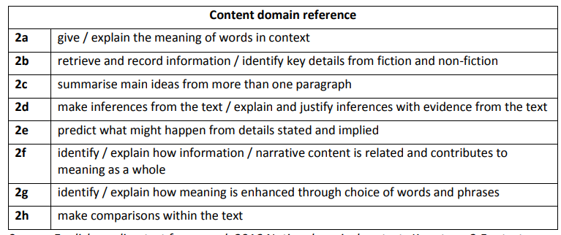
The domains of reading…
In KS2:

Slide 7
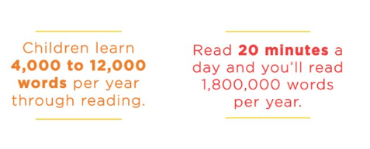
Supporting your child to read at home…
Try to plan for ten to twenty minutes reading with your child AT LEAST three times per week- the more they are immersed in reading, and sharing books with you, the more they will develop the relationship with books that makes them lifelong readers!

Slide 8
Supporting your child to read at home…
Choose an appropriate environment for reading with your child. Try to ensure you are in a comfy, calm space with no competing screens- children read and understand best when they are focused on one task.

Slide 9
Supporting your child to read at home…

Slide 10
Supporting your child to read at home…
Pause and wait- give your child time to decode and understand a text, however tempting it might be to jump in and help.
Make it fun- read in silly voices, act out the scenes, sing the songs.
Be positive about their reading and praise their efforts as much as possible!

Slide 12
Supporting your child to read at home…

