Slide 1
Welcome
Parental presentation on SRE

Slide 2
Why we teach SRE
Relationships Education has been compulsory in key stages 1 and 2 from September 2019
The DfE recommends that primary schools teach SRE in line with Science objectives around conception and birth which is part of the national curriculum for science.
Elements of SRE are taught in Relationship Education order to prepare pupils with the information they need to understand human reproduction and in order to keep themselves safe.
Prepares the children for the physical and emotional changes of puberty

Slide 3
Primary Relationship Education
The focus in primary school is on teaching the fundamental characteristics of positive relationships.
Relationship education in primary should equip pupils to recognise and report abuse. Pupils should understand how to identify where boundaries have been violated, in all contexts, including online.
Pupils will be taught about privacy and children’s rights over their own bodies. Pupils should know how to report concerns and seek advice.

Slide 4
Classroom practice
SRE is taught in Second half of the Summer Term.
Taught in class groups.
Ground rules: respect, listening, not asking personal questions, not making assumptions about other people, having the right to pass if you do not wish to comment.
What is discussed stays in the room, but if concerned about a child’s well-being, we would inform the designated safeguarding lead as per safeguarding policy.

Slide 5
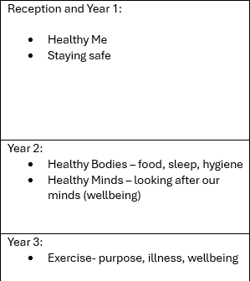
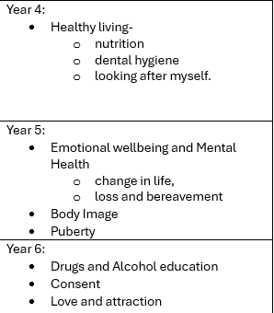

Slide 6
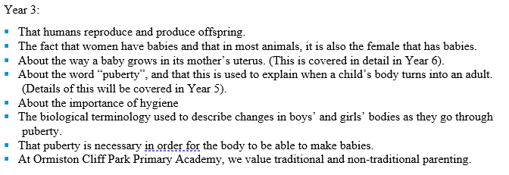

Slide 7
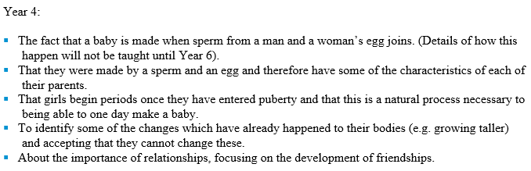

Slide 8
Year 5
Introduction of the term ‘puberty’ and the main changes which occur.
The importance of keeping clean and the products that can help us.
Emotional changes that the children will face during puberty.
The use of scientific vocabulary to understand the functions of genitalia.
An understanding of the menstrual cycle.
Puberty changes for boys and girls.

Slide 9
Year 6
Getting children to think about what constitutes a loving relationship.
Develop an understanding of what attraction is.
Making it clear to children so they understand the concept of consent.
Children can make their own choices about their bodies and behaviour.
An understanding of sexual intercourse including contraception.
What happens during pregnancy?

Slide 10
Withdrawal
If you do not want your child to take part in some or all of the lessons on Sex Education, you can ask that they are withdrawn. At primary level, the head teacher must grant this request.
The Science curriculum in all maintained schools also includes content on human development, including reproduction, which there is no right to withdraw from.

