Slide 1

Ormiston Cliff Park primary Academy
SEN Information Report
2026/2027

Slide 2
Types of SEND
Communication and Interaction | Cognition and learning
Autism Speech and language difficulties Social interaction difficulties | Specific learning difficulties e.g. dyslexia Moderate learning difficulties Chromosomal differences
Social, Emotional and Mental Health (SEMH) | Sensory and / or physical needs
ADHD Attachment disorder Mental health conditions | Vision / hearing difficulties Motor skill difficulties Physical needs

Slide 3
This table shows the number of children at Cliff Park who have been identified as having Special Educational Needs (SEND). This data was correct as of October 2026.
Need | Number | % of school | % of SEND pupils
Communication and interaction | 38 | 9.6% | 51%
Cognition and learning | 13 | 3.3% | 17.5%
Social, Emotional and Mental health | 17 | 4.3% | 23%
Physical / sensory | 6 | 1.5% | 8.1%
EHCPs | 18 | 4.5% | 23%
SEND all groups | 74 | 18.7%

Slide 4
Identification of needs
Needs are identified by collecting information in the following ways:
Talking to parents
Talking to pupils
Assessment, observation and discussion in class
Liaising with external agencies
Transition meetings with previous education providers
Monitoring and assessment data
Pupil progress meetings

Slide 5
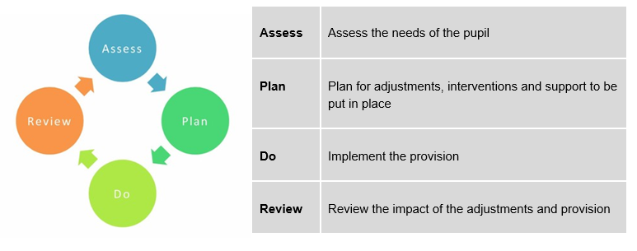
The Graduated approach
This is the approach we follow to identify and support needs. You may also hear it called Assess, Plan, Do, Review which are the stages

Slide 6
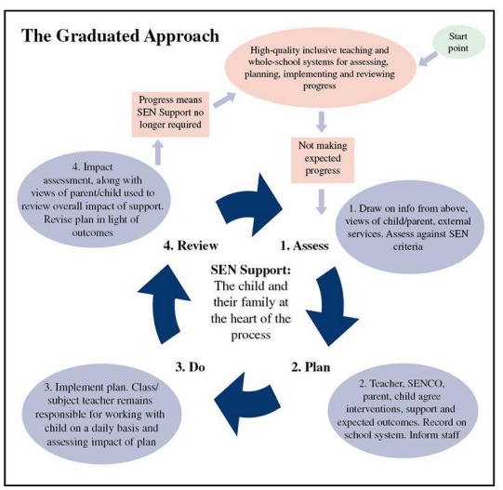
The graduated approach is triggered when it is identified that a pupil is not making the expected level of progress.
Once the pupil has made sufficient progress and no longer needs the support, it is removed and they are supported by our universal offer for all pupils.

Slide 7
Raising a concern
First, speak to your child’s class teacher. You can request a meeting via the office
The class teacher will bring concerns to the SENDCO and we will work together to address them
The SENDCO will work with SLT to address more complex needs or those requiring external support

Slide 8
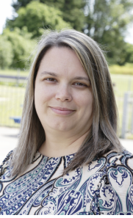
SENDCO – Mrs Janet Upton
01493 661523
j.upton@ocppa.co.uk
I can offer support to identify potential SEN
Make referrals to external agencies
Support with liaising with medical professionals
Support with EHCP applications and reviews
Support with decisions about long term educational provision
If you wish to make an appointment, please contact the school office
Please note:
My working days are Tuesday, Wednesday and Friday. If you need to speak to someone on a different day, please contact the office who will pass your concern on to a member of the leadership team.

Slide 9
Supporting pupils
Multi-agency involvement, child may need an EHCP, specialist advice may be sought, further training for staff, frequent contact with parents
Additional or Different Targeted support needed – record of concern form completed by teacher, APDR in place, school action plan, additional assessments where needed, advice may be sought from outside agencies, additional training for staff as needed
Universal support for all students – quality first teaching, pupil progress meetings, reasonable adaptions, learning walks, book looks, parents’ evenings, whole school policies and procedures

Slide 10
Additional internal support
Phil Reid– Vice Principal and SLT Link to SENDCO
Janet Upton – SENDCO – day to day responsibility for SEND provision in the academy | Bev Edwards– Family Liaison Officer – Children’s Services and support groups, family support | Liz Lavery– Attendance Officer
Naomi James – SEND Lead practitioner for OAT – support and advice for individual pupils and staff as needed.
All teachers and teaching assistants have training in a range of special educational needs. Staff undertake specialist training as required on a pupil-by-pupil basis.

Slide 11
Additional external support
Occupational Therapy – this referral need to be made by a GP but school can support with a letter. | Team around the school meetings with the local authority triage cases and off support where needed. | ATT – Access through technology for pupils with speech or literacy barriers to accessing learning .
Just One Norfolk – link to School health. Can support developmental progress or health needs including speech and language concerns. | School and Community team – individual referrals and school- based interventions for pupils with emerging need. | Sensory support team – Advice and support for school around pupils with sensory impairments.
Speech and language therapy team – individual pupil referrals after intervention in school. Seen at home or school. | Community Paediatrician – Newberry Clinic. This referral is made by a GP but school can support with a letter. | Mental health support team – Individual referrals for pupils with emerging mental health needs. Staff work with the parent to support the child.

Slide 12
Useful contacts
Family Action – support for families at any stage of the SEND journey | British Dyslexia Association - British Dyslexia Association (bdadyslexia.org.uk) | Sunbeams play – Great Yarmouth – support for children with autism
NANSA – Norfolk and Norwich SEND Association – support and activities Nansa SENsational Families | Nansa | SENDIASS – free impartial advice for parents SENDIASS Home - Kids | Autism Anglia – Charity supporting people with autism

Slide 13
Evaluating our provision
Classroom observations
Data analysis
Pupil feedback
Parent feedback
OAT quality assurance procedures
Assessment of progress made
We monitor and evaluate our provision using a range of methods.

Slide 14
Governors
Having an understanding of how we identify need
Understanding how the school allocates and spends SEND funding
Helping in reviews of SEND policy and ensure SEND law is upheld
Our SEN governor visits the school regularly to understand the processes used in supporting pupils with SEND.
Governors support our school by:

Slide 15
Access to the curriculum
We provide the following to support children to access their learning
Pre/post teaching
Small group interventions
Additional resources
Adult support
Additional time
Movement breaks
Seating arrangements
Access to technology where available
Equipment such as pencil grips, overlays, chair bands, writing slope etc.
Programmes set by external professionals
Adaptions to tasks

Slide 16
Access to enrichment activities
We want all pupils to have access to the enriching activities offered in our academy.
We will provide:
Appropriate staff to support children where needed
Flexible arrangements to meet individual needs
Discussion with parents / external professionals around adaptions to the activity
Additional risk assessments / training

Slide 17
How we support health and wellbeing
Whole school ethos that values everyone as an individual.
Safeguarding team supporting behaviour, attendance, SEN and Mental health.
Whole school Zones of Regulation
Care plans for pupils requiring medical or personal care
Support with transition between years groups and on to high school.
Whole-school work with the mental health support team.

Slide 18

Pastoral support
Behaviour support
Mental health team
PSHE lessons
School council
Additional support
Emotional literacy
Social skills groups
Home school liaison
Family liaison officer

Slide 19
Transition
School Entry | Year group transition | High school
SENCO visits local nurseries to meet children with additional needs | Staff liaise with previous teachers and pass on information to support pupils | SENDCO supports parents to select high school – visits for parents in spring term of year 6
Reception children visit before starting school | SENDCo meets with new year group staff and arranges training as needed | Transition meetings between staff
SENDCO contacts previous school of pupils joining mid-year |  | Additional visits for pupils
Pupils and parents meet leadership team and SENDCO before joining mid-year

Slide 20
Involving parents and children
Parents
Children
Parents evening
Informal meetings
Written reports
Appointments
School Council
Pupil voice meetings
Assessment for learning in class
Pastoral meetings

Slide 21
Complaints procedure
If you have concerns around the school’s SEND provision, please speak to us directly so that we can work together to do our best for your child.
If you feel you want to progress to a more formal complaint, please make your complaint in writing. This will then be investigated by the Principal or, if the complaint relates to the Principal, by the Primary Director from Ormiston Education Trust.
For more information about making a complaint please see our academy complaints policy - here

Slide 22
Ofsted Comments
Pupils, including those with special educational needs become bolder and more inquisitive in their learning.
Leaders have redesigned the curriculum. It is anchored in leaders’ high expectations and their commitment to inclusivity.
A few students, including some with SEN struggle. Adults provide them with enthusiastic, well-judged support.
The academy was inspected in March 2022.
Below are comments made by inspectors after speaking to staff, parents and pupils.

Slide 23
Parent comments
Our parents of pupils with SEND have commented on the following strengths of our provision:
Teachers always listen and try to help
I can always talk to someone on the gate
He has made so much progress this year
I can’t believe how much difference the small tweaks made

Slide 24
Pupil comments
I like my chair band because it lets me move my legs.
Mrs…. is the TA. When I get stuck she helps me.
If I fall out with my friends, Mrs…. helps us figure out what happened.
When I use my green card to take a break it really helps me concentrate

Slide 25

Norfolk Local offer
Norfolk County Councils offer for children and young people with SEND can be found here
https://www.norfolk.gov.uk/article/40393/SEND-Local-Offer

Slide 26
Our SEND policy
A link to our SEND policy on our website can be found here
Ormiston Cliff Park Primary Academy follows the Special Educational Needs Code of Practice 0-25 years SEND_Code_of_Practice_January_2015.pdf (publishing.service.gov.uk)

